Slide 1
Employee Data Analysis using Excel
STUDENT NAME: ALIS ESTHAR RANI.Y
REGISTER NO: 122200072
DEPARTMENT: B.COM (CS)
COLLEGE: PACHAIYAPPA'S COLLEGE FOR WOMEN'S, KANCHIPURAM.

Slide 2
PROJECT TITLE
SALARY AND COMPENSATION ANALYSIS THROUGH EXCEL DATA MODELING

Slide 3


AGENDA
Problem Statement
Project Overview
End Users
Our Solution and Proposition
Dataset Description
Modelling Approach
Results and Discussion
Conclusion
3/21/2024 Annual Review

Slide 4

PROBLEM STATEMENT
HR department and compensation analysts face significant challenges in maraging employee salary and compensation data, leading to inaccurate pat decision, inequitable competition, lack of transparency, and compliance risks.

Slide 5

PROJECT OVERVIEW
"This project aims to develop a comprehensive Excel data model to analyze and manage employee salary and compensation data, providing insights for informed decision-making. The scope includes designing a user-friendly dashboard for interactive data visualization, leveraging Excel's advanced analytics capabilities such as Power Query, Power Pivot, and macros, and creating a scalable and adaptable solution for ongoing compensation management and planning.
.

Slide 6

WHO ARE THE END USERS?
1. HR and Compensation Teams: HR professionals, compensation analysts, benefits administrators, and payroll managers who need to analyze and manage employee compensation data.
2. Business Leaders and Managers: Business leaders, line managers, and department heads who require insights to make informed decisions about employee compensation and benefits.

Slide 7

OUR SOLUTION AND ITS VALUE PROPOSITION
1. HR Professionals: HR generalists, compensation analysts, benefits administrators, and HR managers. 2. Compensation and Benefits Managers: Professionals responsible for designing and managing compensation and benefits programs. 3. Financial Analysts: Analysts who support HR and compensation teams with financial data analysis and planning.

Slide 8
Dataset Description
Dataset Name: Compensation_Data Description: This dataset contains employee compensation data, including salary, benefits, and bonus information. Fields: 1. *Employee_ID* (unique identifier) 2. *Name* 3. *Job_Title* 4. *Department*

Slide 9

THE "WOW" IN OUR SOLUTION
1. Instant Insights: Get real-time insights into compensation data, enabling swift and informed decisions. 2. Automated Analysis: Leverage Excel formulas and macros to automate complex analysis and reporting.
3/21/2024 Annual Review
9

Slide 10
MODELLING
1. Data Integration: Combine data from various sources (e.g., HR systems, payroll, surveys) into a single Excel model. 2. Data Cleansing: Ensure data accuracy and consistency by cleaning and preprocessing the data.
10

Slide 11
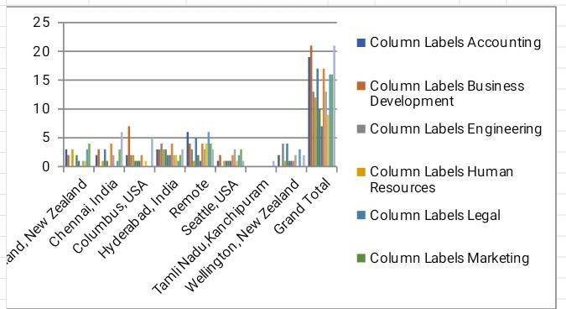
RESULTS
11

Slide 12
conclusion
- Develop a robust and dynamic compensation framework - Ensure market competitiveness and internal equity - Identify and address pay disparities and inconsistencies - Optimize compensation packages for attracting and retaining top talent - Inform data-driven decisions on compensation adjustments, promotions, and new hires - Improve employee satisfaction and engagement - Enhance transparency and compliance with regulatory requirements

